Slide 1
NLP Word Embeddings lecture 04.1
Branko Žitko
Source: DeepLearning.AI

Slide 2
Contents
Word Representation
Properties of word embeddings
Embedding matrix
Learning word embeddings
Word2Vec
Negative sampling
Debiasing word embeddings

Slide 3
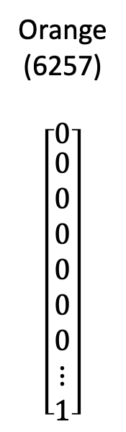

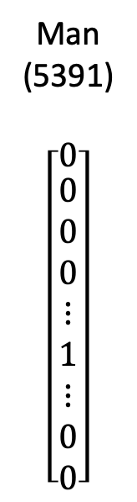
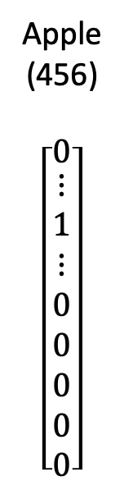

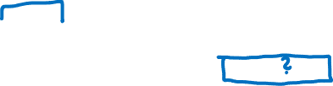
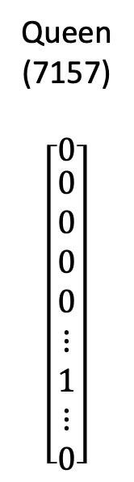
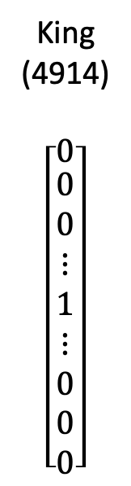

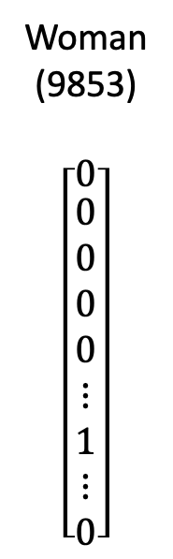

Word representation
V = [a, aaron, …, zulu, <UNK>]
1-hot representation
Man
(5391)
$$\left[\begin{matrix}0 \\ \begin{aligned}0 \\ 0 \\ 0 \\ ⋮ \\ 1 \\ ⋮ \\ 0 \\ 0\end{aligned}\end{matrix}\right]$$
Woman
(9853)
$$\left[\begin{matrix}0 \\ \begin{aligned}0 \\ 0 \\ 0 \\ 0 \\ ⋮ \\ 1 \\ ⋮ \\ 0\end{aligned}\end{matrix}\right]$$
King
(4914)
$$\left[\begin{matrix}0 \\ \begin{aligned}0 \\ 0 \\ ⋮ \\ 1 \\ ⋮ \\ 0 \\ 0 \\ 0\end{aligned}\end{matrix}\right]$$
Queen
(7157)
$$\left[\begin{matrix}0 \\ \begin{aligned}0 \\ 0 \\ 0 \\ 0 \\ ⋮ \\ 1 \\ ⋮ \\ 0\end{aligned}\end{matrix}\right]$$
Apple
(456)
$$\left[\begin{matrix}0 \\ \begin{aligned}⋮ \\ 1 \\ ⋮ \\ 0 \\ 0 \\ 0 \\ 0 \\ 0\end{aligned}\end{matrix}\right]$$
Orange
(6257)
$$\left[\begin{matrix}0 \\ \begin{aligned}0 \\ 0 \\ 0 \\ 0 \\ 0 \\ 0 \\ ⋮ \\ 1\end{aligned}\end{matrix}\right]$$
I want a glass of orange ______.
I wan a glass of apple ______.
Notes:
So far we've been representing words using a vocabulary of words and vocabulary from the previous week might be say 10,000 words.
We've been representing words using a 1-hot vector so for example if man is word number 5391 in this dictionary then you represent it with a vector with a 1 in position 5391. We are going to use O subscript 5391 to represent this vector where O here stands for 1-hot
Then if women is word number 9853 then you represent it with O_9853 which just has a one in position 9853 and zeros elsewhere.
King Queen Apple Orange would be similarly represented with 1-hot vectors
One of the weaknesses of this representation is that it treats each word as a thing for itself and it doesn't allow an algorithm to easily generalize across words.
For example let's say you have a language model that has learned that when you see "I want a glass of orange ___" well what do you think the next word will be?
The relationship between apple and orange is not any closer as the relationship between any of the other words man-woman, king-queen and so it's not easy for the learning algorithm to generalize from knowing that orange juice is a popular thing.
So recognizing that apple juice might also be a popular thing or a popular phrase and this is because the inner product between any two different one-hot vectors is zero.
If you take any two vectors, Inner product is zero and euclidian distance between any pair of these vectors is also the same so it just doesn't know that somehow Apple and Orange are much more similar than King an Orange or Queen and Orange.

Slide 4





Featurized representation: word embedding
Man
(5391)
Woman
(9853)
King
(4914)
Queen
(7157)
Apple
(456)
Orange
(6257)
-0.95
0.93
0.7
0.02
0.97
0.95
0.69
0.01
0.00
-0.01
0.03
0.95
0.01
0.00
-0.02
0.97
I want a glass of orange ______.
I wan a glass of apple ______.
Notes:
It would be nice if instead of a 1-hot representation we can instead learn a thicker ice representation where for each of these words Man, Woman, King, Queen, Apple, Orange or really for every word in the dictionary we can learn a set of features and values for each of the.
So for example each of these words might have what is the gender associated with each of these things so if gender goes from -1 for males and +1 for female then then if we are actually learning these things maybe for King you get -0.95 and for Queen +0.97 and the app when our interests you
know sort of genderless
Another feature might how royal are these things and so the terms man and women are optically royal so they may have features values close to 0.
King and Queen are highly royal and Apple and Orange are not to the royal.
How about age, well Man and Woman doesn't connote much about age maybe men and women implies that they're adults but you know maybe neither necessarily young nor old so maybe values close to zero.
Whereas kings and queens are almost always adults an Apple an Orange might be more neutral respect to age.
And then another feature is for example a food. Well Man is not a food Woman is not a food. Neither are Kings and Queens but Apples and Oranges are fruits and
There can be many other features as well ranging from: what is the size of this, what is the cost, is this something that is related to life, is this an action or is thi is a verb or is it something else and so on
So you can imagine coming up with many features and for the sake of illustration let's say um 300 different features and what that does is it allows you to take this list of numbers I've only written for here but this could be a list of maybe 300 numbers that then becomes a 300 dimensional vector for representing the
word man and I'm going to use the notation e5391 to denote a representation like this and similarly this vector this 300 original
vector or 300 emotional vector like this
I would denote e9853 to denote a 300 dimensional vector we could use to represent the word Women and similarly
for the other examples here now
If you use this representation to represent the words Orange and Apple then notice that the representations for Orange and Apple are now quite similar.
Some of the features will differ because maybe the color of an orange and color of an apple, the taste order or some other features were differ.
But by and large along the features of apple and orange are actually the same or take on very similar values and so this increases the odds of the learning algorithm that has figured out that orange juice is a thing to also quickly figure out that apple juice is a thing so this allows it to generalize better across different words
so over the next few videos we'll find a way to learn word embeddings which is may seem to learn high dimensional feature vectors like these that gives a
better representation than one heart
vectors for representing different words
and the features we'll end up learning
won't have a easy to interpret
interpretation like that component one
is gender component two is royal
component for your age and so on exactly
what the representing will be a bit
harder to figure out but nonetheless the
future eyes representations would really
learn will allow an algorithm to quickly
figure out that

Slide 5



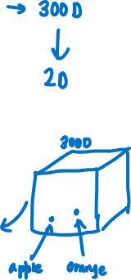




Visualizing word embeddings
man
woman
king
dog
queen
cat
fish
four
grape
apple
tree
two
one
orange
Notes:
Apple and orange are more similar than say King and orange or green and orange
if we're able to learn a 300 dimensional feature vector or 300 dimensional embedding for each words one of the popular things to
do is also to take this 300 dimensional data and embed it say in a two dimensional space so that you can visualize them and so one common
algorithm for doing this is the t-SNE algorithm or PCA and similar.
if you look at one of these embeddings one of these representations you find that words like man and women tend to get grouped together
A king and queen and get grouped together and
These are the people which tend to get grouped together
Those are animals who can get to group together, the fruits will tend to be close to each and numbers like 1, 2, 3, 4 will be close to each other.
And then maybe the animates objects as people and animals also tend to get grouped together.
But you see plots like these sometimes on the internet to visualize some of
these 300 or higher dimensional
embeddings and maybe the
did you sense that were the embedding
algorithms like these can learn similar
features for concepts that feel like
they should be more related as
visualized by that concepts that seem to
you and me like they should be more
similar end up getting mapped to more
similar feature vectors and these
representations will use these solar
feature eyes representations in maybe a
300 dimensional space these are called
embeddings and the reason we call them
embedding this you can think of a 300
dimensional space and again the contour
of the interdimensional spaces make this
a 3d one and what you do is you take
every word like orange and you you know
have a 300 dimensional feature vector so
the word orange gets embedded to a point
in this 300 dimensional space and the
word Apple gets embedded to a different
point in this PNG dimensional space and
of course to visualize it outlives liked
easily mapped is so much lower
dimensional space you can actually plot
the 2d data and and look at it but

Slide 6

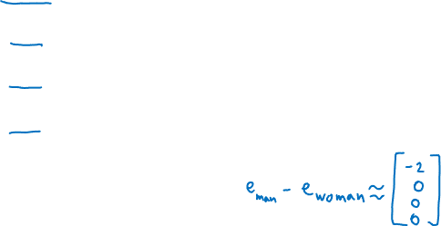

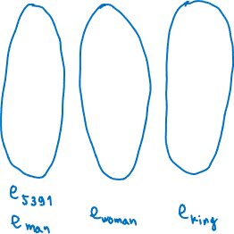
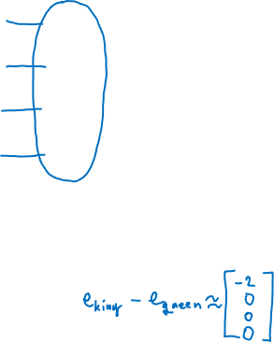
Analogies
Man
(5391)
Woman
(9853)
King
(4914)
Queen
(7157)
Apple
(456)
Orange
(6257)
Gender
Royal
Age
Food
-1
0.01
0.03
0.04
1
0.02
0.02
0.01
-0.95
0.93
0.7
0.02
0.97
0.95
0.69
0.01
0.00
-0.01
0.03
0.95
0.01
0.00
-0.02
0.97

Slide 7
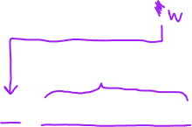



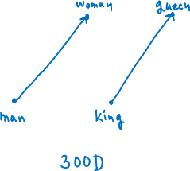
Analogies using word vectors
man
woman
dog
king
cat
queen
fish
four
tree
grape
apple
two
one
orange
$$e_{man}−e_{woman}≈e_{king}−e_{?}$$

Slide 8
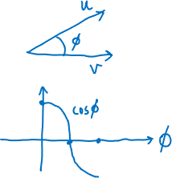


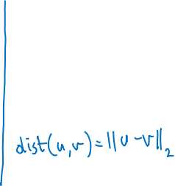

Cosine similarity
$$sim\left(e_{w}, e_{king}−e_{man}+e_{woman}\right)$$
Man : Woman as Boy : Girl
Ottawa : Canada as Nairobi : Kenya
Big : Bigger as Tall : Taller
Yen : Japan as Ruble : Russia

Slide 9
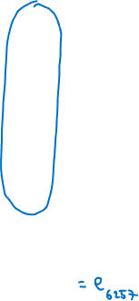
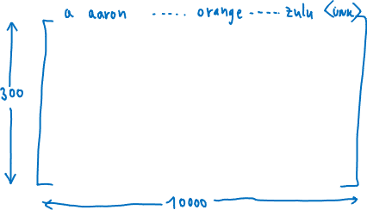
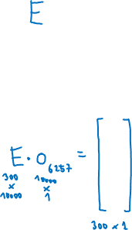
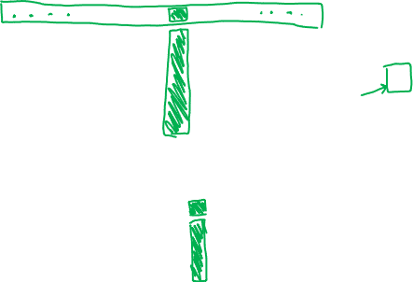
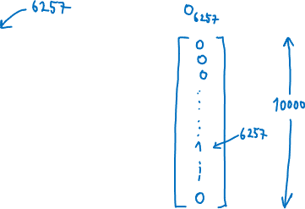

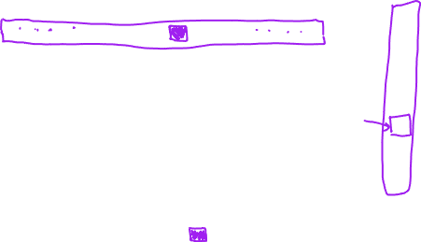
Embedding matrix

Slide 10
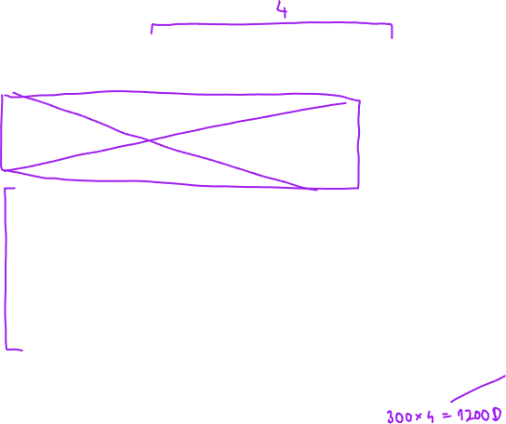
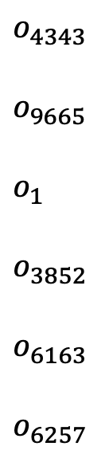

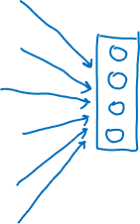

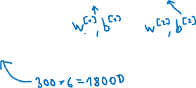

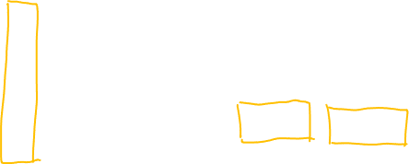
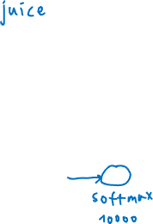
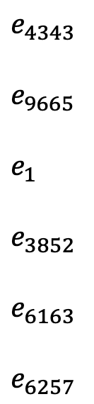

Neural language model
I
4343
want
9665
a
1
glass
3852
of
6163
orange
6257
______ .
I
want
a
glass
of
orange
$o_{4343}$
$o_{9665}$
$o_{1}$
$o_{3852}$
$o_{6163}$
$o_{6257}$
$⟶$
$⟶$
$⟶$
$⟶$
$⟶$
$⟶$
$E$
$E$
$E$
$E$
$E$
$E$
$⟶$
$⟶$
$⟶$
$⟶$
$⟶$
$⟶$
$e_{4343}$
$e_{9665}$
$e_{1}$
$e_{3852}$
$e_{6163}$
$e_{6257}$

Slide 11


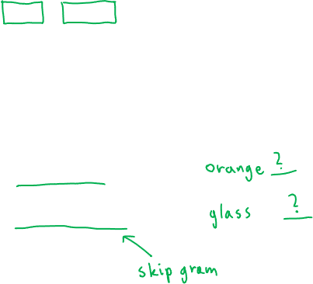

Other context/target pairs
I want a glass of orange juice to go along with my cereal.
Context:
Last 4 words
4 words on left & right
Last 1 word
Nearby 1 word

Slide 12
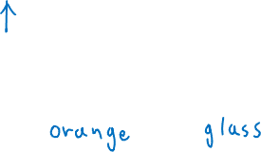
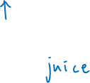
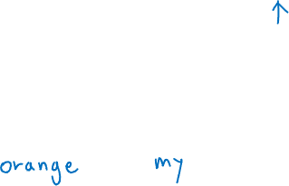
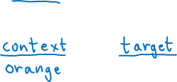
Skip-grams
I want a glass of orange juice to go along with my cereal.

Slide 13



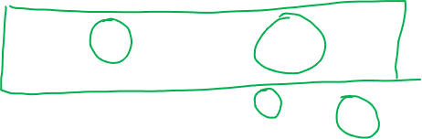



Model
Vocab size = 10000

Slide 14

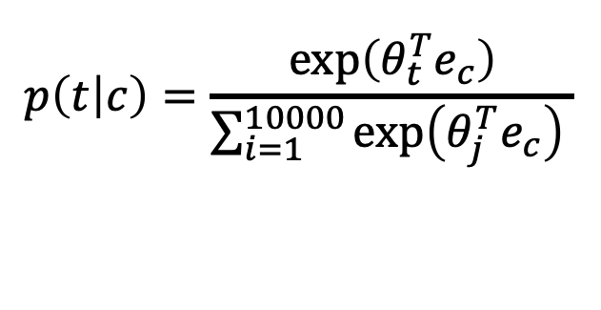
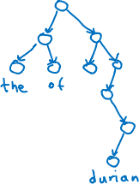
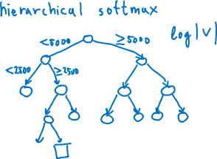

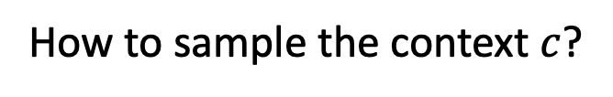
Problems with softmax classification
$$p\left(t | c\right)=\frac{\exp\left(θ_{t}^{T}e_{c}\right)}{\sum_{i=1}^{10000}{\exp\left(θ_{j}^{T}e_{c}\right) }}$$
How to sample the context $c$?

Slide 15


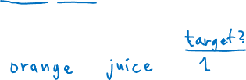
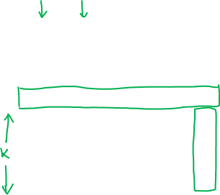
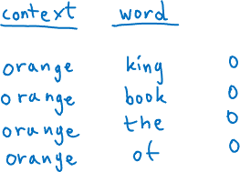
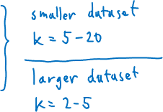
Defining a new learning problem
I want a glass of orange juice to go along with my cereal.

Slide 16
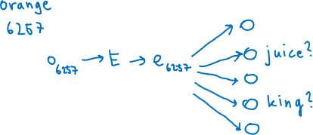
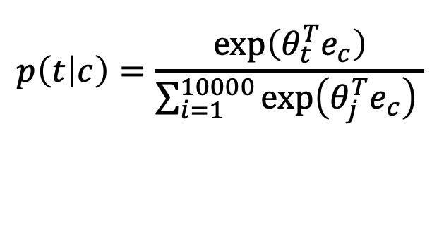
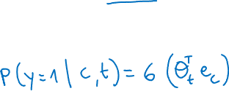

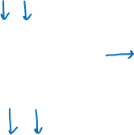
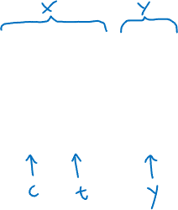
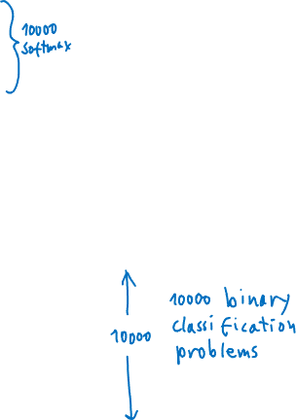
Model
$$p\left(t | c\right)=\frac{\exp\left(θ_{t}^{T}e_{c}\right)}{\sum_{i=1}^{10000}{\exp\left(θ_{j}^{T}e_{c}\right) }}$$
context
orange
orange
orange
orange
orange
word
juice
king
book
the
of
target?
1
0
0
0
0
softmax:

Slide 17
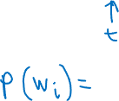
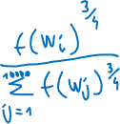



Selecting negative samples
context
orange
orange
orange
orange
orange
word
juice
king
book
the
of
target?
1
0
0
0
0

Slide 18
The problem of bias in word embeddings
Man : Woman as King : Queen
Man : Computer_Programmer as Woman : Homemaker
Father : Doctor as Mother : Nurse
Word embeddings can reflect gender, ethnicity, age, sexual orientation, and other biases of the text used to train the model.

Slide 19








The problem of bias in word embeddings
1. Identify bias direction.
2. Neutralize: for every word that is not definitional, project to get rid of bias.
3. Equalize pairs

